Slide 1

AASD 4000
Machine Learning - I
Applied AI Solutions Developer Program

Slide 2
Module 06 Feature Selection
Vejey Gandyer

Slide 3
Agenda
Feature Selection
Importance of Feature Selection
Feature Selection Checklist
Filter Feature Selection Methods
Wrapper Feature Selection Methods
Embedded Feature Selection Methods

Slide 4
Feature Selection
What is it?

Slide 5
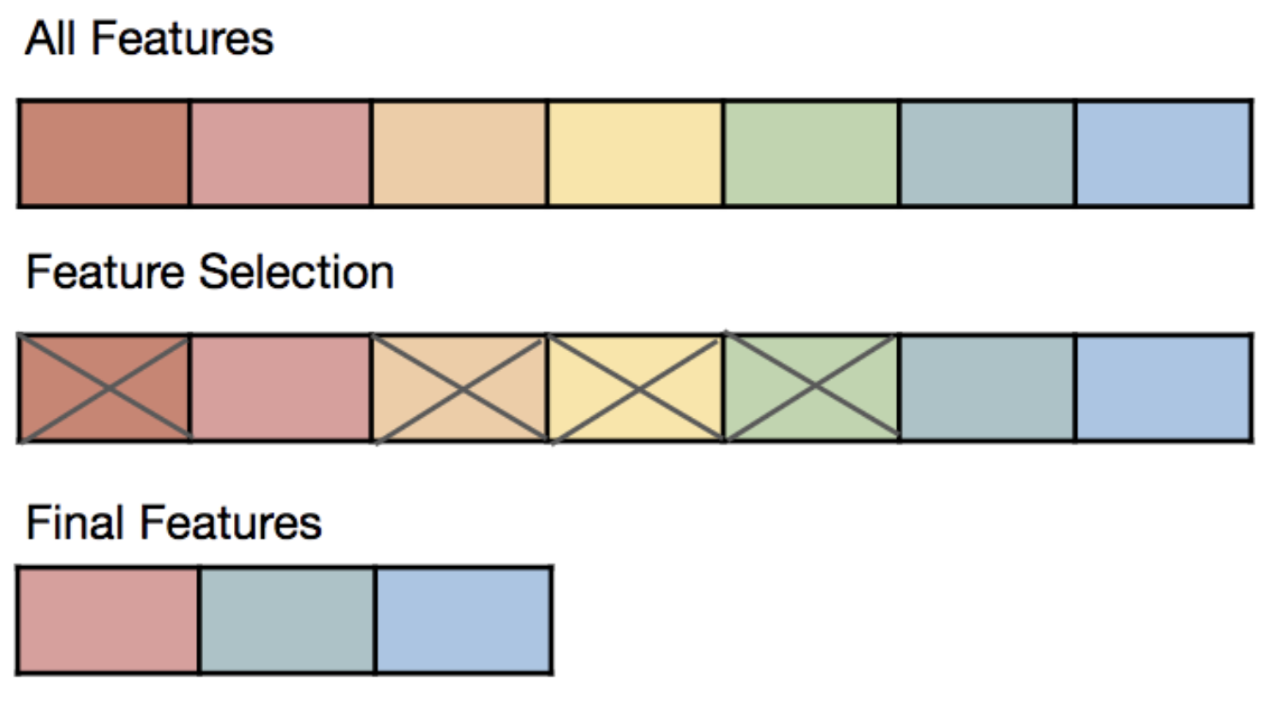
What is Feature Selection ?
When building a machine learning model in real-life, it’s almost rare that all the variables in the dataset are useful to build a model.
Feature selection is the process of finding and selecting the most useful features in a dataset.

Slide 6
Importance of Feature Selection
Why it is needed?

Slide 7
Importance of Feature Selection
Faster Training
Fewer features enables the machine learning algorithm to train faster
Occam's Razor
Fewer features reduces the complexity of a model and makes it easier to interpret
Garbage-in Garbage-out
Fewer and important features improves the accuracy of a model if the right subset is chosen
Curse of dimensionality
Fewer features reduces overfitting

Slide 8
Feature Selection Checklist
Source: https://jmlr.csail.mit.edu/papers/volume3/guyon03a/guyon03a.pdf

Slide 9
Do you have domain knowledge? If yes, construct a better set of ad hoc”” features
Are your features commensurate? If no, consider normalizing them.
Do you suspect interdependence of features? If yes, expand your feature set by constructing conjunctive features or products of features, as much as your computer resources allow you.
Do you need to prune the input variables (e.g. for cost, speed or data understanding reasons)? If no, construct disjunctive features or weighted sums of feature
Do you need to assess features individually (e.g. to understand their influence on the system or because their number is so large that you need to do a first filtering)? If yes, use a variable ranking method; else, do it anyway to get baseline results.
Do you need a predictor? If no, stop
Do you suspect your data is “dirty” (has a few meaningless input patterns and/or noisy outputs or wrong class labels)? If yes, detect the outlier examples using the top ranking variables obtained in step 5 as representation; check and/or discard them.
Do you know what to try first? If no, use a linear predictor. Use a forward selection method with the “probe” method as a stopping criterion or use the 0-norm embedded method for comparison, following the ranking of step 5, construct a sequence of predictors of same nature using increasing subsets of features. Can you match or improve performance with a smaller subset? If yes, try a non-linear predictor with that subset.
Do you have new ideas, time, computational resources, and enough examples? If yes, compare several feature selection methods, including your new idea, correlation coefficients, backward selection and embedded methods. Use linear and non-linear predictors. Select the best approach with model selection
Do you want a stable solution (to improve performance and/or understanding)? If yes, subsample your data and redo your analysis for several “bootstrap”.

Slide 10
Filter Feature Selection Methods

Slide 11
Filter Methods
Relies only on the data to be evaluated and not on the machine learning algorithm
Assessment criterion : distance, information, dependency, and consistency
Uses ranking technique and uses the rank ordering method for variable selection
Features give rank based on statistical scores
- determine features' correlation with the outcome variable

Slide 12
Filter Feature Selection Methods
Pearson Correlation

Slide 13
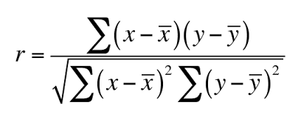
Pearson Correlation
Check the absolute value of Pearson's correlation between the target and numerical features in the dataset
Keep the top n features that satisfies this criterion

Slide 14
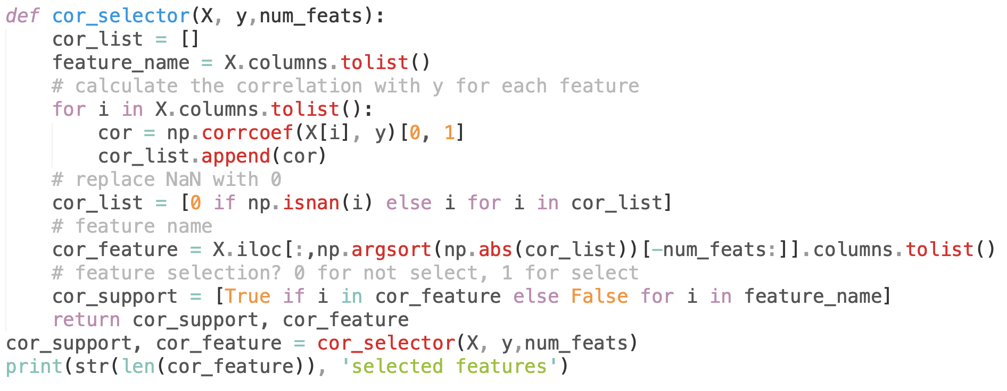
Pearson Correlation

Slide 15
Filter Feature Selection Methods
Chi-Squared

Slide 16
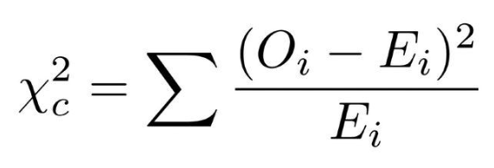
Chi-Squared
Check the chi-square metric between the target and numerical features in the dataset
Select the feature that has maximum chi-squared values
Categorical features
Expected Frequency > 5

Slide 17
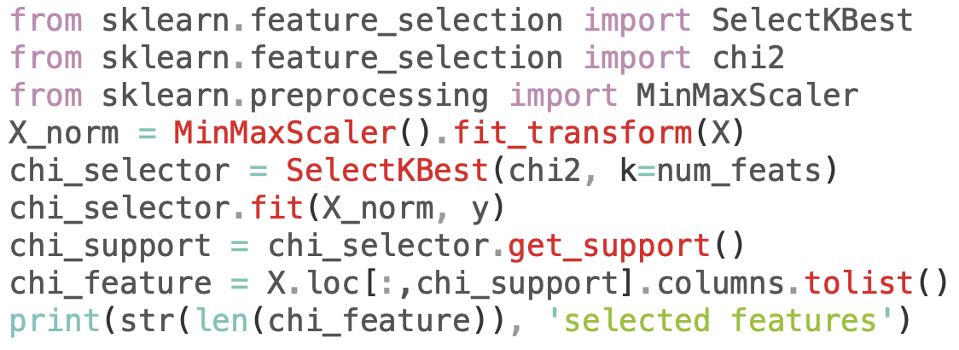
Chi-Squared

Slide 18
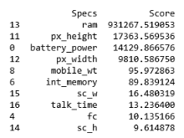
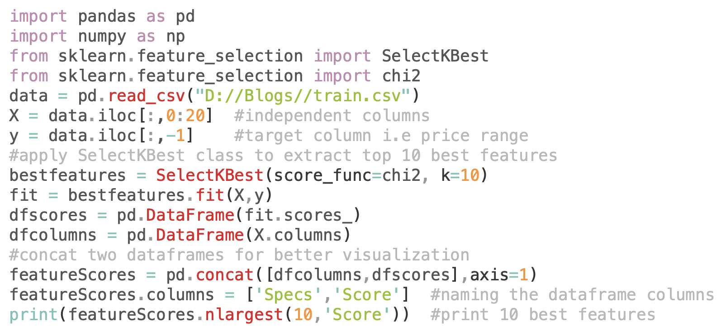
Case Study: Mobile Price Prediction https://www.kaggle.com/iabhishekofficial/mobile-price-classification#train.csv

Slide 19
Filter Feature Selection Methods
Mutual Information Gain

Slide 20
Mutual Information Gain
Calculates the reduction in entropy from the transformation of a dataset
Choose the feature with best information gain value with respect to target variable

Slide 21
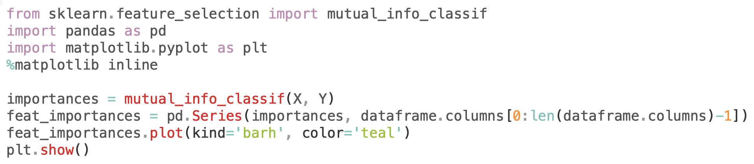
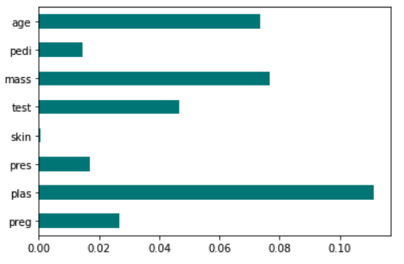
Mutual Information Gain

Slide 22
Filter Feature Selection Methods
Fisher's Score

Slide 23
Fisher's score
Calculates Fisher's score between target and feature
Returns the ranks of features based on the fisher's score
Select top n features

Slide 24
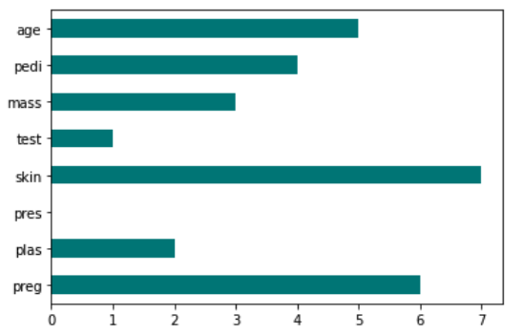
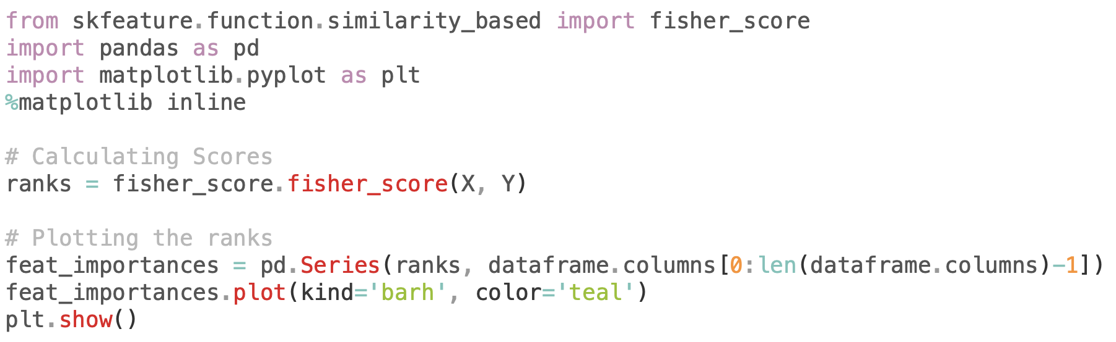
Fisher's score

Slide 25
Filter Feature Selection Methods
Correlation Coefficient with Heat Map

Slide 26
Correlation Coefficient
Correlation: Measure of linear relationship of 2 or more features
Good features – highly correlated with target, uncorrelated amongst other features
Heatmap - easy visualization

Slide 27
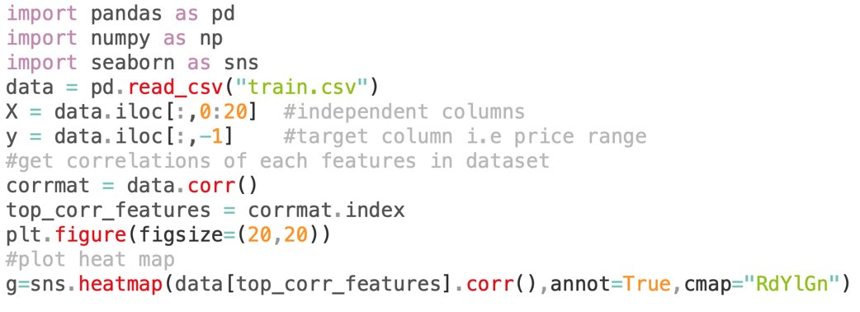
Correlation Coefficient

Slide 28
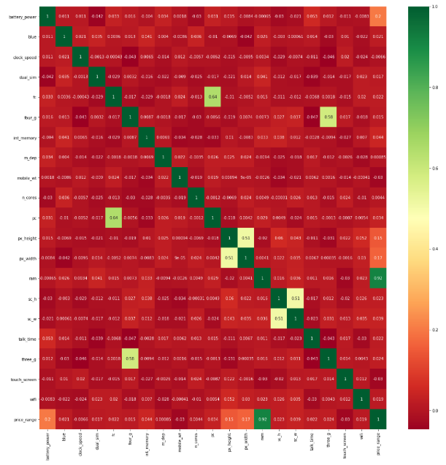

Slide 29
Filter Feature Selection Methods
Variance Threshold

Slide 30
Variance Threshold
Removes all features whose variance doesn't meet a threshold
Removes all zero-variance features
get_support() returns Boolean value – True means variable does not have zero variance

Slide 31
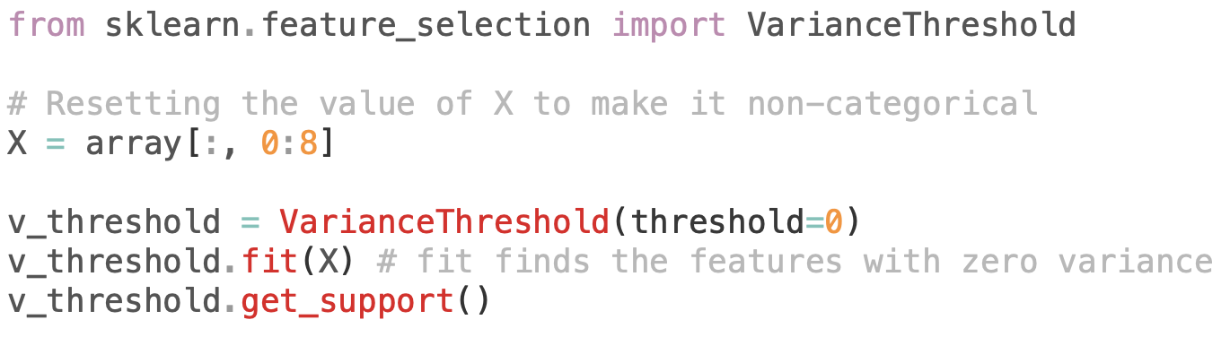
Variance Threshold

Slide 32
Filter Feature Selection Methods
Mean Absolute Difference (MAD)

Slide 33
Mean Absolute Difference (MAD)
Computes the absolute difference from the mean value
Higher the MAD, higher the discriminatory power, so good feature

Slide 34
Filter Feature Selection Methods
Dispersion Ratio

Slide 35



Dispersion Ratio
Measure of dispersion applies the Arithmetic Mean and Geometric Mean
Higher dispersion, more relevant feature

Slide 36
Wrapper Feature Selection Methods

Slide 37
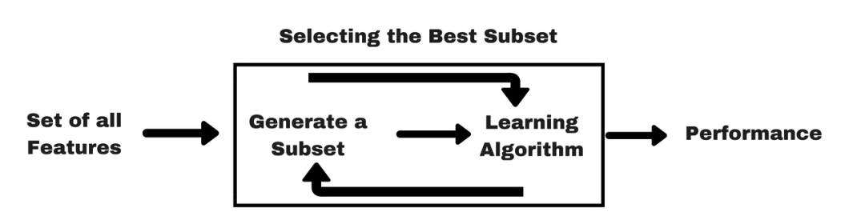
Wrapper Methods
Use a subset of features to train a model
Add or remove features depending on the inference accuracy
Search through a feature space to identify the best features

Slide 38
Wrapper Feature Selection Methods
Forward Feature Selection

Slide 39
Forward Feature Selection
Iterative method
No feature at the start
At each iteration, keep adding feature that best improves the performance of model
Repeat until no improvement is observed

Slide 40
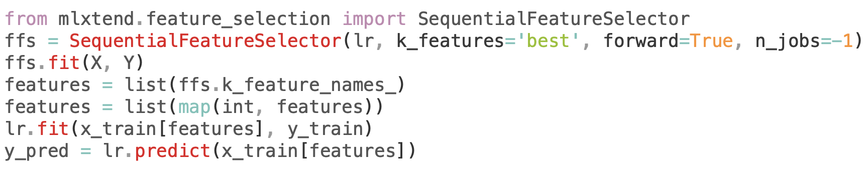
Forward Feature Selection

Slide 41
Wrapper Feature Selection Methods
Backward Feature Elimination

Slide 42
Backward Feature Elimination
Iterative method
All features at the start and build a model
At each iteration, keep removing feature that does not affect performance of model
Repeat until preset criterion is achieved

Slide 43
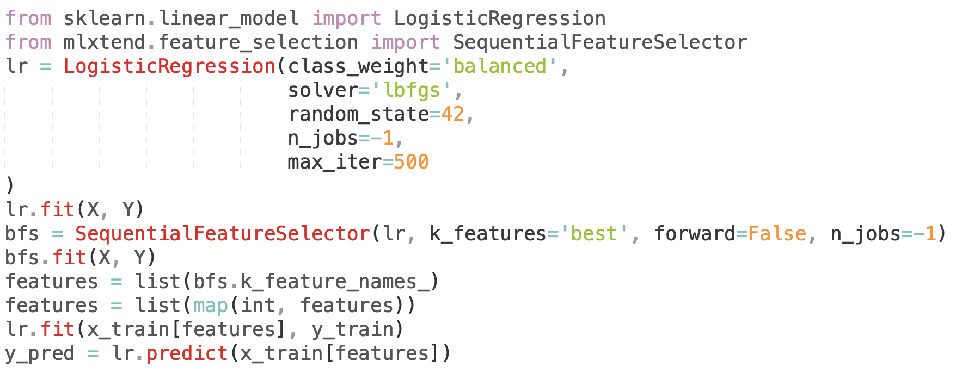
Backward Feature Elimination

Slide 44
Wrapper Feature Selection Methods
Exhaustive Feature Selection

Slide 45
Exhaustive Feature Selection
Iterative method
Brute-force evaluation of each feature subset
At each iteration, it tries every possible combination of features and measures the performance
Returns the best performing feature subset

Slide 46
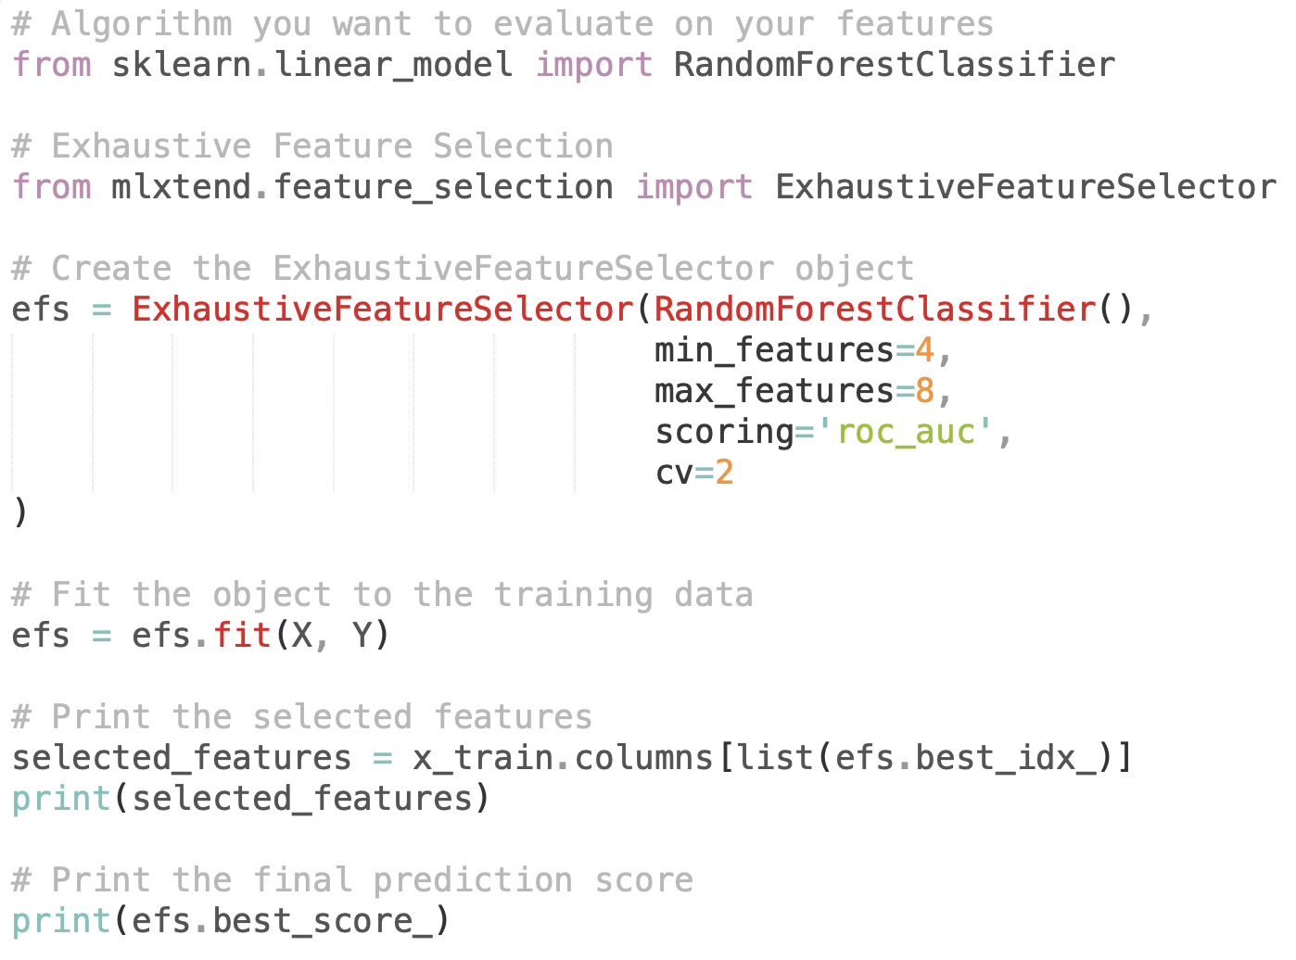
Exhaustive Feature Selection

Slide 47
Wrapper Feature Selection Methods
Recursive Feature Elimination

Slide 48
Recursive Feature Elimination
Given an external estimator that assigns weights to features, the goal of RFE is to select features by recursively considering smaller and smaller sets of features
Estimator is trained on initial set of features and importance of each feature is obtained
Then, the least important features are pruned from the current set of features
Repeat until desired number of features is reached

Slide 49
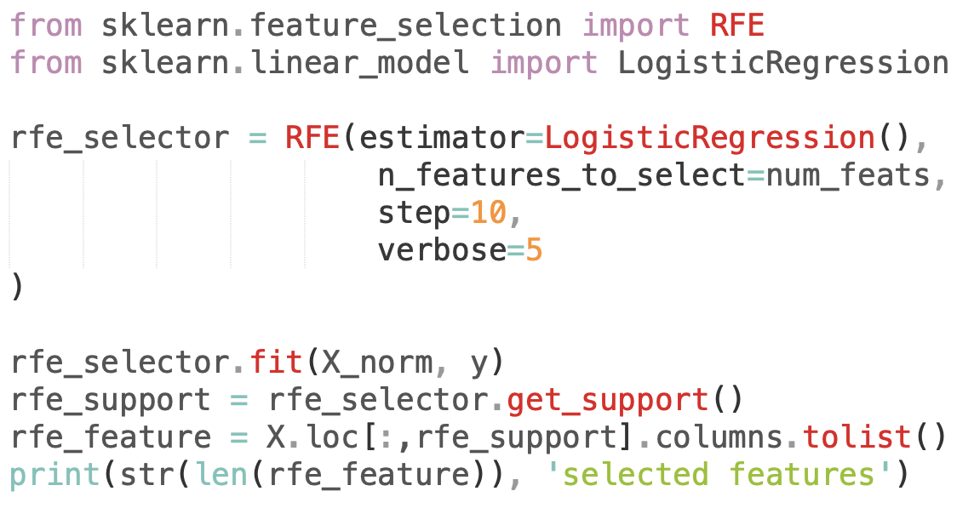
Recursive Feature Elimination

Slide 50
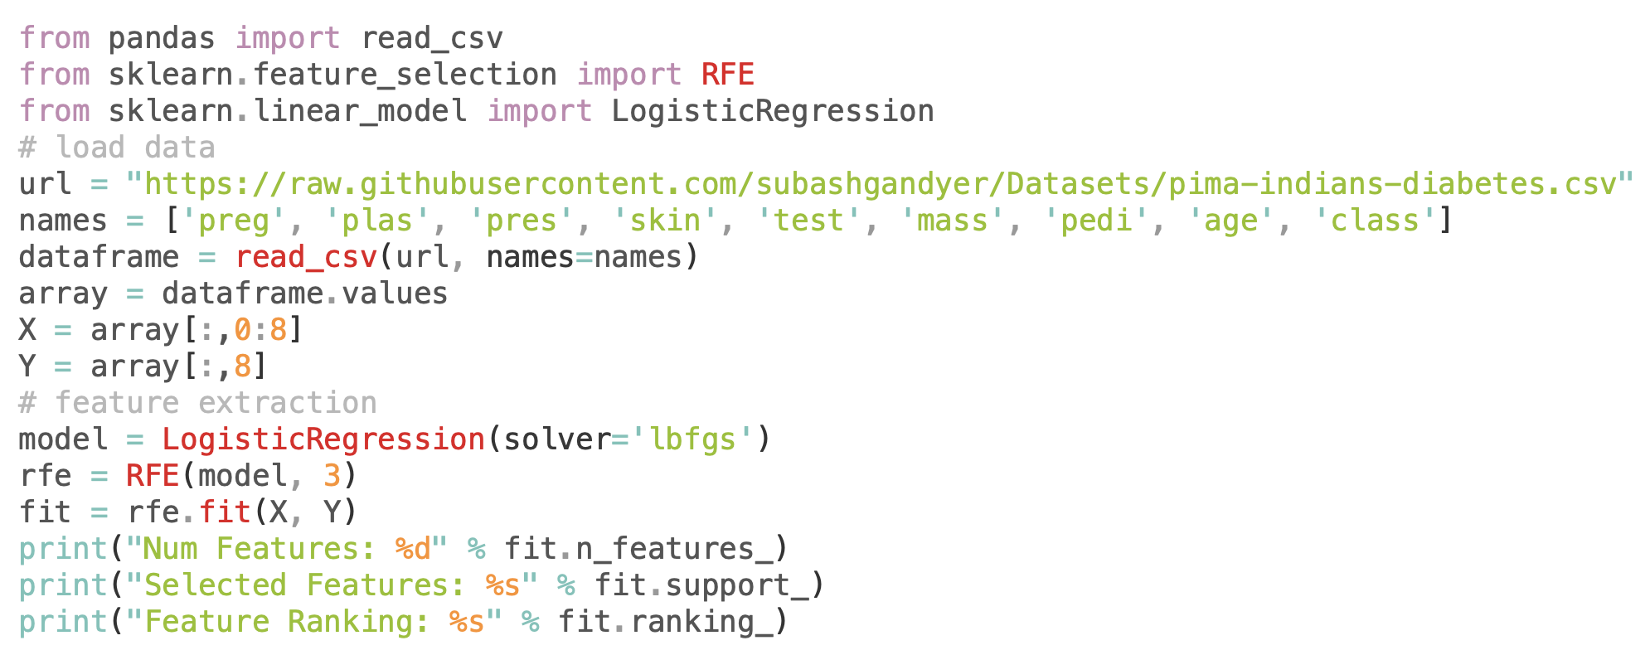
Case Study: Pima Indian Diabetes Dataset
Num Features: 3
Selected Features: [ True False False False False True True False]
Feature Ranking: [1 2 3 5 6 1 1 4]

Slide 51
Embedded Feature Selection Methods

Slide 52
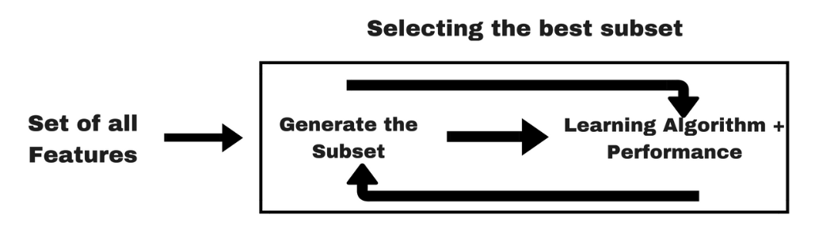
Embedder Methods
Combines the best worlds of both filter and wrapper methods
Lasso and Ridge Regularizations come under this method

Slide 53
Embedded Feature Selection Methods
Lasso (L1)

Slide 54
Lasso Regularization (L1)
Adding penalty to parameters of the model to reduce the freedom of the model thereby avoiding over-fitting
Adds penalty to absolute value of the magnitude of coefficients
Penalty is applied over coefficients that multiply each of the predictors
Ability to shrink some of the coefficients to zero, therefore that feature can be removed from the model

Slide 55
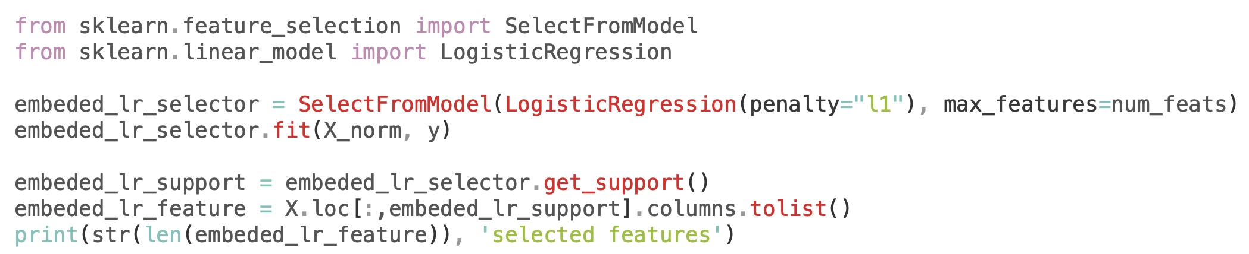
Lasso Regularization (L1)

Slide 56
Embedded Feature Selection Methods
Random Forest Importance

Slide 57
Embedded Feature Selection Methods
Tree-based: RandomForest

Slide 58
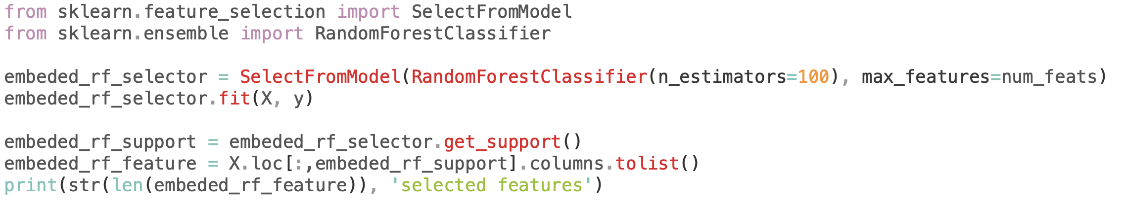
RandomForest: SelectFromModel

Slide 59
Embedded Feature Selection Methods
Tree-based: LightGBM

Slide 60
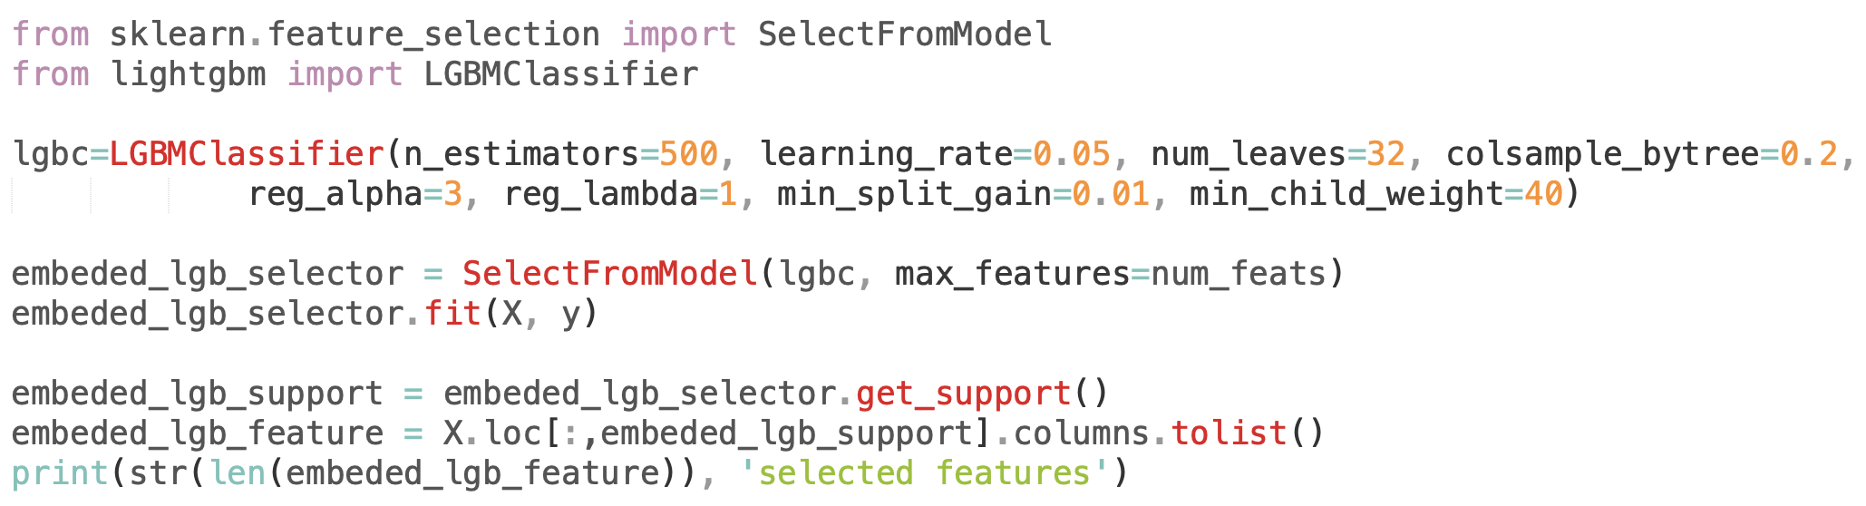
LightGBM: SelectFromModel

Slide 61
Task7: Create AutoFS tool
Create an AutoFS tool that will select the best features for a given dataset using a set of different feature selection methods on different algorithms

Slide 62
Exercise: Bringing it all together AutoFS
Use the previous code scripts in creating an AutoFS tool where you have to pass the dataset you want to analyze and get the best features from a set of algorithms you want to model

